Slide 1
International Sports Arbitration
Presented by
Jeff Benz
JAMS

Slide 2
Largest Sport in the World?
American Football?
Baseball?
Ice Hockey?
Basketball?
Soccer?

Slide 3
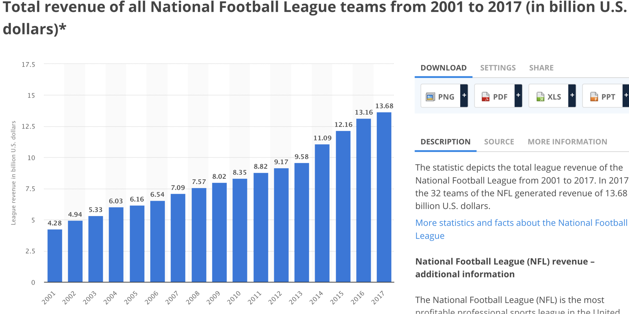

Slide 4
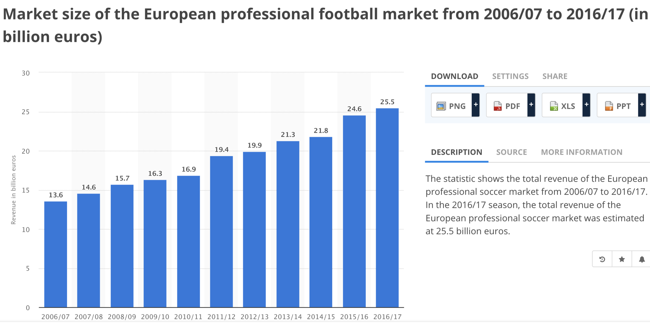

Slide 5
International Arbitration Issues in Sport
New York Convention
Consent/Jurisdiction
The Court of Arbitration for Sport

Slide 6
COURT OF ARBITRATION FOR SPORT
International Council for Arbitration in Sport
Closed list or a very very very closed list
  Disclosures/Disqualification
Number of cases annually
Procedure
  Impact of legal traditions
Hearings
Awards
Innovations
  Ad Hoc Division—the need for speed
    Fast free fair
  The Seat-always Lausanne
Recourse to SFT under Swiss PILA

Slide 7
Types of Cases
Doping
Football
  Player transfer
  Player and coach employment agreements
  Financial Fair Play in Europe
Eligibility/Selections Cases (how do I get to compete)
Governance
Sponsorship/licensing
Other commercial

Slide 8
Putting It All In Context: Doping and Football
The Perils of Being a Sports Arbitrator Pre-World Cup

Slide 9
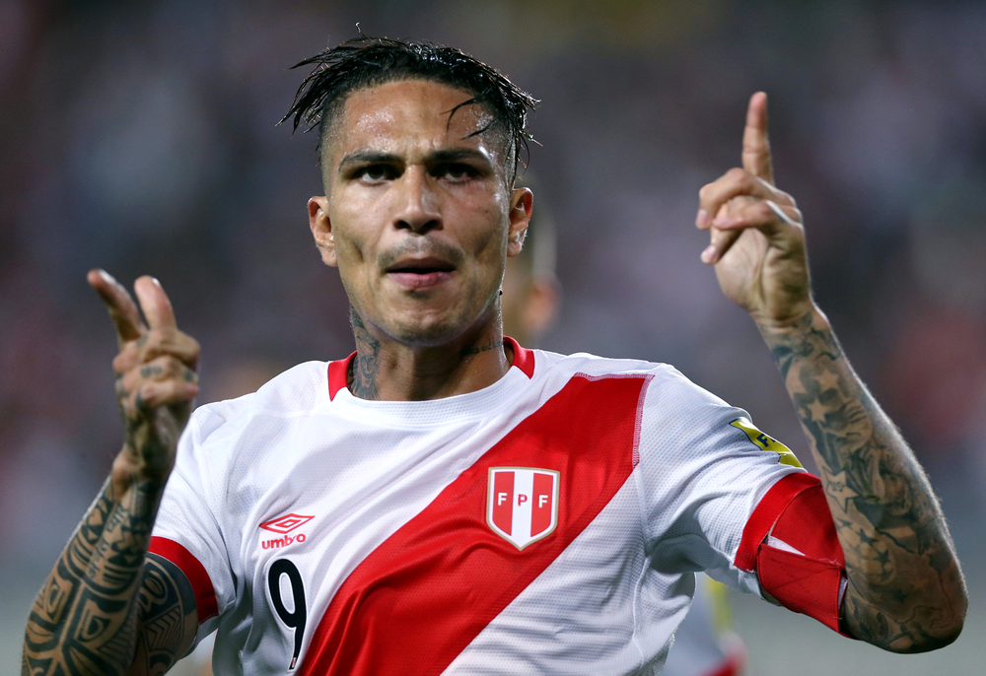
Paolo Guerrero
Peru national team captain tests positive for cocaine metabolites in small amounts
Drinking coca tea
Fault analysis? Proportionality? Punishment?

Slide 10
Paolo Guerrero
Only options for punishment under WADC:
  Reprimand, no sanction
  12 Months to 24 Months
  24 Months

Slide 11
CAS Hearing
How many Peruvians live in Switzerland?

Slide 12
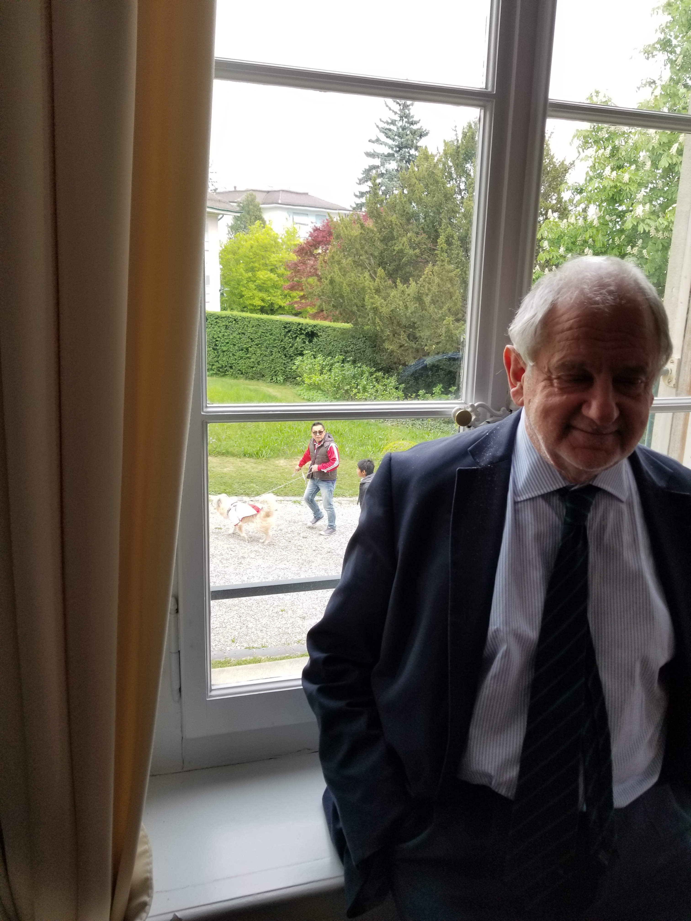


Slide 13
Outcome
  FIFA Disciplinary Committee: 12 months
  FIFA Appeal Committee: 6 months (impossible sanction!)
  WADA appeals
  CAS: 14 months (some fault)
  SFT Activity

Slide 14
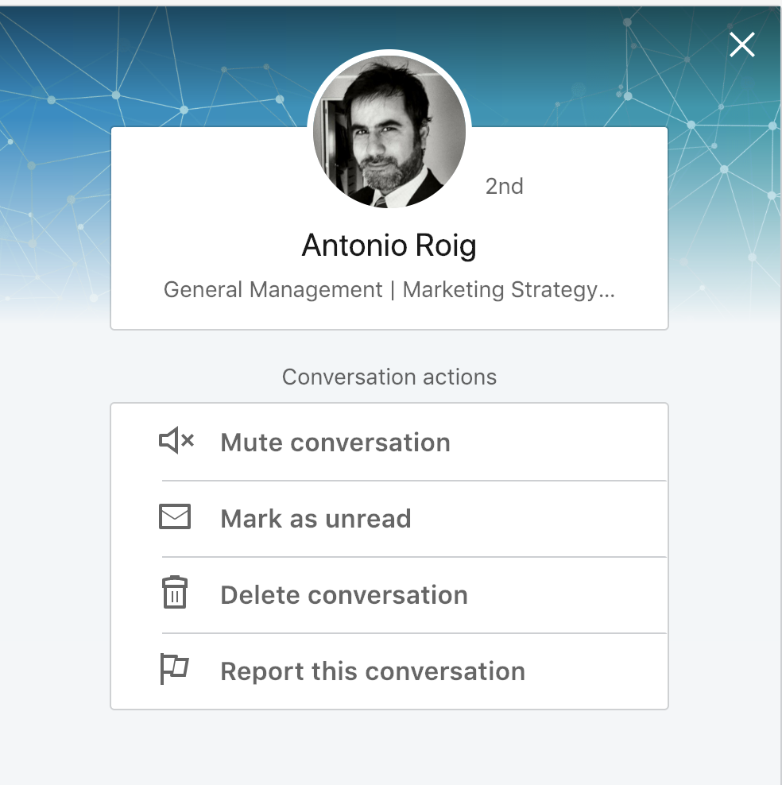
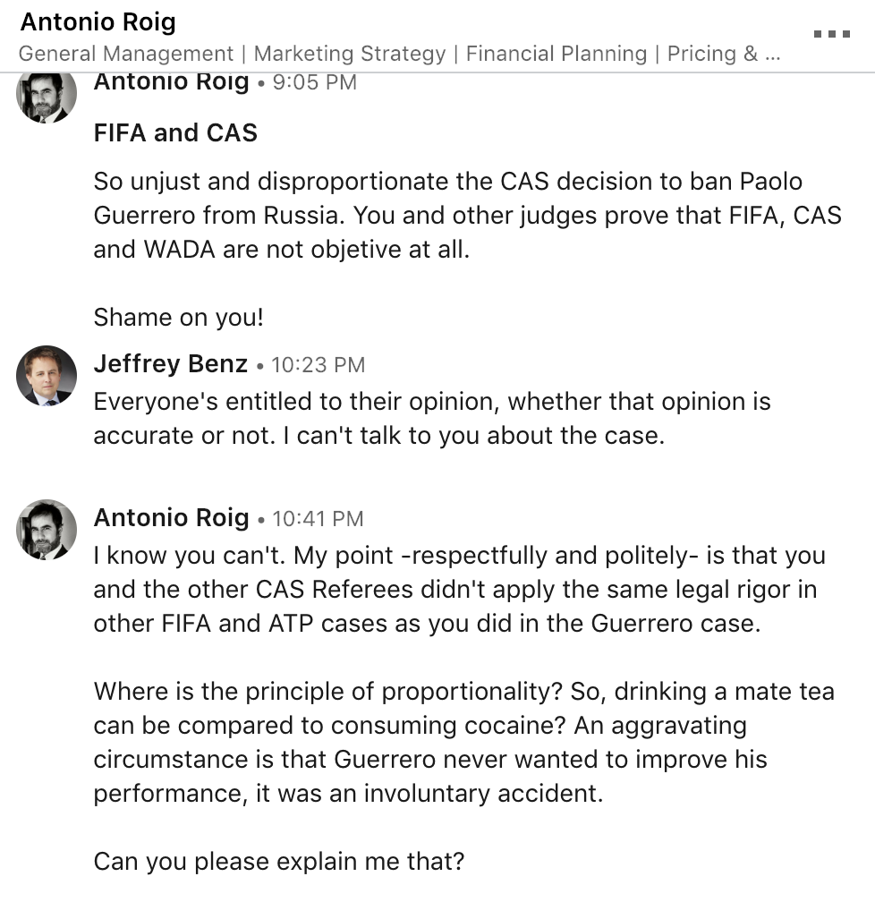
More feedback…

Slide 15
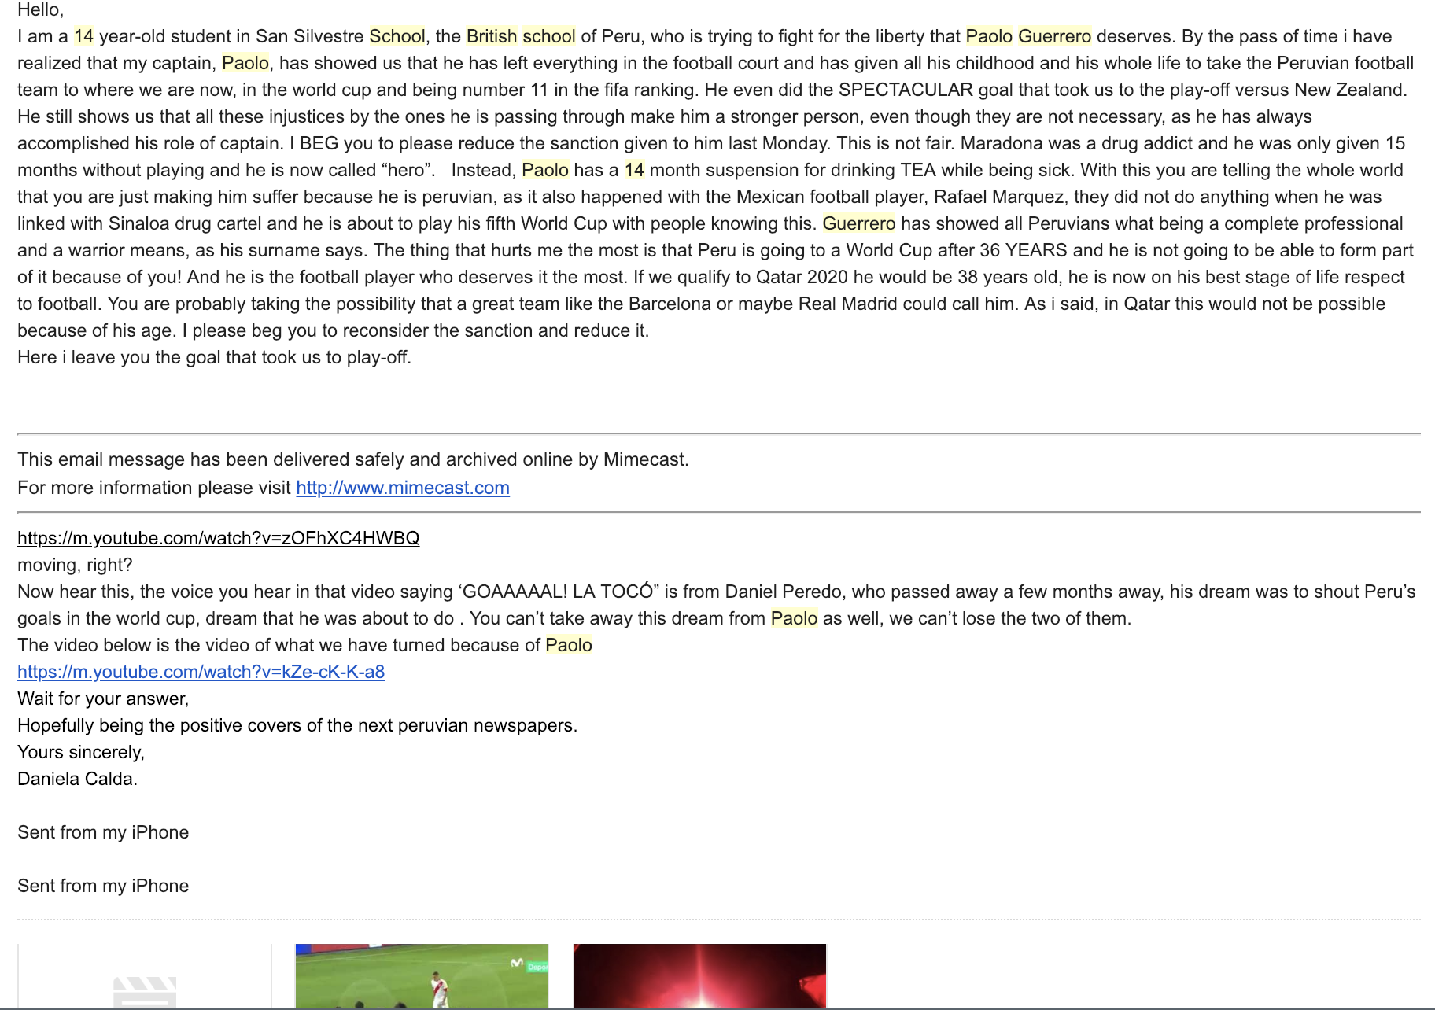
14 Year Old Passion for Paolo/Futball

Slide 16
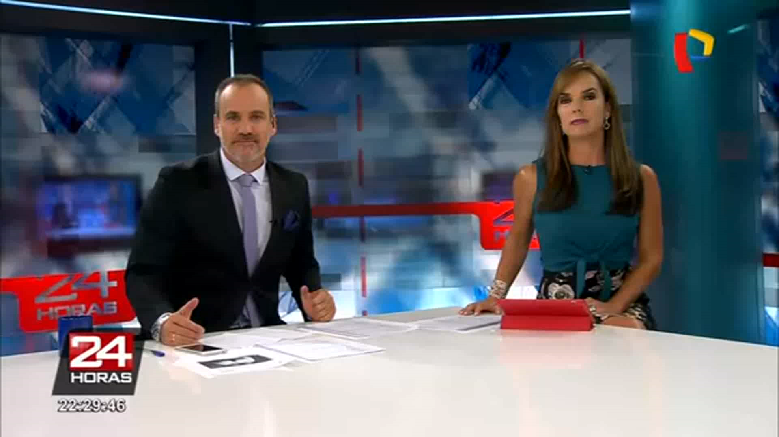
More Feedback

Slide 17
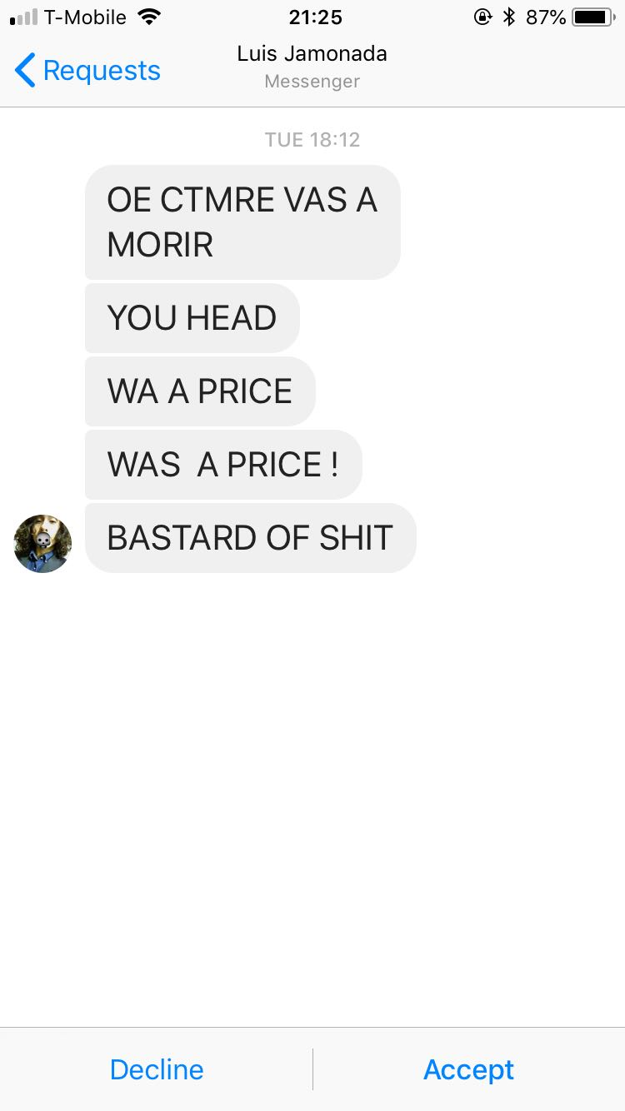
More Feedback

Slide 18
And yes, more feedback
World Cup Team Captains’ Letter
President of Peru
Etc!

Slide 19
Still More Feedback for One of Us On Wikipedia
Michael Jacob Beloff, QC is an English barrister. A member of Blackstone Chambers, he practises in a number of areas including human rights and administrative law.

Slide 20
Still More Feedback for One of Us On Wikipedia
Final new sentence: He is one of the three men who ruined Paolo Guerrero’s football career.

Slide 21
Legal Commentary
“Seldom has the law been as big an ass as in the case of Peru centre forward Paolo Guerrero”.
-Rigozzi & Quinn

Slide 22
Questions?
Thank you!
JEFF BENZ
Arbitrator Mediator Special Master
Fellow, Chartered Institute of Arbitrators
Fellow, College of Commercial Arbitrators
Attorney (CA, CO, HI, NY), Barrister England & Wales
CEDR and IMI Accredited Mediator
Certified E-Discovery Specialist
Adjunct Law Professor, Pepperdine University Straus Institute
JAMS
Los Angeles
www.jamsadr.com
4 NEW SQUARE BARRISTERS
Lincoln's Inn | London WC2A 3RJ | UK
+44 20 7822 2000(o) | +44 (0) 75512 03530(m)
www.4newsquare.com

